Slide 1
REVENUE & TAXATION
TUMUSIIME AGGREY
LLB /PG-DIP LDC / MBA-TELM
t.agry@yahoo.com

Slide 2
OBJECTIVES OF MODULE
Define Taxation
Explain the Types and Forms of Taxes
Explain the characteristics of a good tax system
Explain the role of taxation in national economy
Explain the sources of primary and secondary taxation

Slide 3
LEGAL AUTHORITIES
The Constitution of the Republic of Uganda 1995 as Amended
Uganda Revenue Authority Act cap 218
Income Tax Act, Cap. 338
Customs Duty Act, Cap. 336
Tax Procedure Code Cap 343
Surcharges (Revenue) Act Cap 340
Tax Appeals Tribunal Act Cap 341
East African Customs Management Act
East African Excise Management Act

Slide 4
LEGAL AUTHORITIES
Stamps Act, Cap. 339
Traffic and Road Safety Act, Cap. 347
Value Added Tax Act, Cap. 344
Tax Exemption (UPF, IPF, UPS) Act Cap 342
Finance Acts (Various) i.e Public Finance Management Act / Anti- Corruption Act / PPDA
Lotteries and Gaming Act, Cap.334
Decided cases
www.ura.go.ug

Slide 5
TAX DEFINED
Blacks Laws Dictionary
Defines a Tax as a monetary charge imposed by Government on personal entities, transactions or property to yield public revenue.

Slide 6
TAXATION DEFINED
Taxes are compulsory payments associated with consumption or holding of property that individuals and corporations are required to make each year to Government.
Taxes are usually charged on :-
Income (y)
Goods and Services
Property
Taxes are levied and enforced by Government

Slide 7
MANDATE
Article 152 of the constitution provides;-
Taxation.
(1) No tax shall be imposed except under the authority of an Act of Parliament.
(2) Where a law enacted under clause (1) of this article confers powers on any person or authority to waive or vary a tax imposed by that law, that person or authority shall report to Parliament periodically on the exercise of those powers, as shall be determined by law.
(3) Parliament shall make laws to establish tax tribunals for the purposes of settling tax disputes.

Slide 8
TAX APPEALS TRIBUNAL (TAT)
In Uganda Revenue Authority v Rabbo Enterprises (U) Ltd and Mt. Elgon Hardwares Ltd, the central issue was whether the High Court had original jurisdiction to hear a tax dispute.
The High Court held that it was not a tax tribunal and the dispute should first have been presented before the TAT. The High Court deals with tax appeals from the tribunal. The respondents appealed to the Court of Appeal, which held that article 139(1) of the Constitution and the Judicature Act (Cap. 13) give the High Court unlimited original jurisdiction to hear all matters and, therefore, the High Court and the TAT enjoyed concurrent jurisdiction. The appellant appealed to the Supreme Court.

Slide 9
CLASSIFICATION OF TAXES
Direct and Indirect Taxes
A direct tax is one which is levied on the income or profits of the person who pays it rather than on good or services. These include:- PAYE and Income Tax
And
Indirect Tax is passed on to the consumer as part of the purchase price of a good or service. These include: - VAT , Insurance and Communications Tax.

Slide 10
COMMON EXAMPLES OF TAXES IN UGANDA
Household (Personal (y) tax)
Consumer expenditure- VAT
Business Receipts from retail sales
Employment (PAYE)
Dividends
Property Tax
Communication tax ie telecommunications
Import and Export Tax

Slide 11
Rationale for taxes in Uganda
The role of taxes is to help governments fund various undertakings such as public works, infrastructure, and wars The role of taxes is to help governments fund various undertakings such as public works, infrastructure, and wars .
Economic stability: Taxes can be used as a tool to stabilize the economy by influencing consumer spending, investment, and savings. Governments can adjust tax rates and policies to encourage economic growth, control inflation, and manage fiscal deficits.
Redistributing wealth: Taxes can be used to redistribute wealth from higher-income individuals and businesses to lower-income individuals.
Encouraging responsible behavior.
Promoting Social goods.

Slide 12
PriAnciples of taxation
The principles of taxation are the basic guidelines that governments follow when designing and implementing tax policies. These principles help ensure that taxes are fair, efficient, and effective in achieving their intended goals. Some of the key principles of taxation include:
Equity
Certainty
Convenience
Efficiency
Flexibility
Simplicity
Notes:
Equity: The principle of equity states that taxes should be fair and proportionate to an individual's ability to pay. This can be achieved through progressive taxation, where tax rates increase as income levels rise, ensuring that higher-income individuals contribute a larger share of their income in taxes.
Certainty: The principle of certainty states that taxpayers should know how much tax they owe and when it is due. Tax laws should be clear and transparent, and taxpayers should be able to easily understand their tax obligations.
Convenience: The principle of convenience states that taxes should be easy to pay and administer. Tax systems should be simple, efficient, and not overly burdensome for taxpayers to comply with.
Efficiency: The principle of efficiency states that taxes should be levied in a way that minimizes economic distortions and maximizes economic growth. Tax policies should be designed to achieve their intended goals with minimal negative impact on economic behavior.
Neutrality: The principle of neutrality states that taxes should not favor or discriminate against particular individuals, industries, or activities. Tax policies should be neutral and not distort economic decision-making.
Flexibility: The principle of flexibility states that tax systems should be able to adapt to changing economic conditions and government priorities. Tax policies should be flexible enough to respond to new challenges and opportunities as they arise.
Simplicity: The principle of simplicity states that tax systems should be easy to understand and administer. Complex tax laws and regulations can lead to compliance issues and administrative costs, so tax policies should be as simple as possible.

Slide 13
Types of taxes in Uganda
Income Tax
In Uganda, income tax applies generally to all types of persons who derive income, whether an individual, bodies of individuals, or corporate entities.
Resident persons are taxed on worldwide income, while non-resident persons are taxed only on income derived from sources in Uganda.
Income tax is imposed on three broad categories of income – Business income, Employment income and Property income.

Slide 14
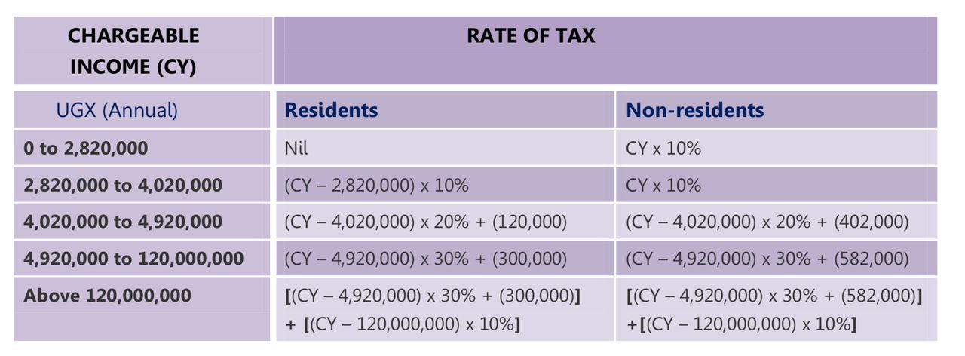
INCOME TAX - INDIVIDUAL
Notes:
The income tax rate for individuals depends on the income bracket in which the individual falls. Resident individuals enjoy a tax free annual income threshold of UGX. 2,820,000 per annum. The balance is taxed at 10%, 20% or 30% depending on the income bracket. Individuals who earn above UGX 120,000,000 pa pay an additional 10% on the income above 120m.

Slide 15
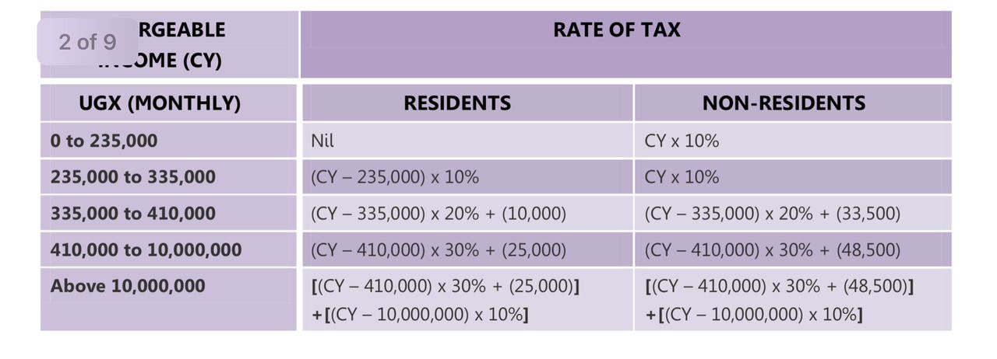
PAYE - TAX - INDIVIDUAL

Slide 16
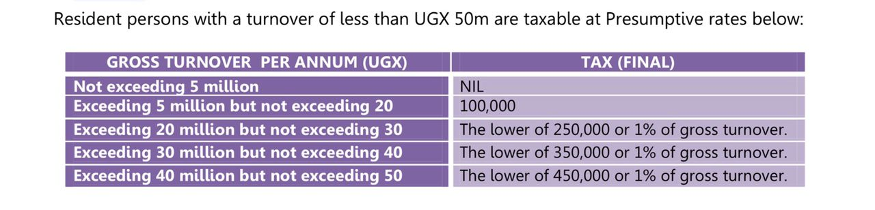
BUSINESS INCOME UNDER 50M

Slide 17
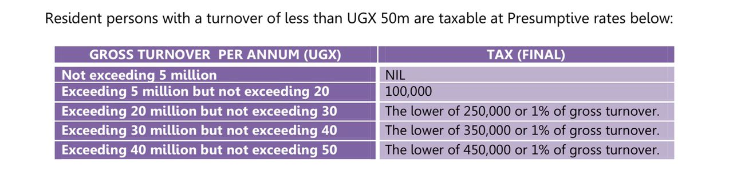

Slide 18
RENTAL TAX
Tax on rental income derived by an individual is assessed separately from the individual’s other business incomes or employment income.
The tax is 20% of the rental income amount after deducting
1) 20% as allowable expenses; and
2) UGX 2,820,000 as a tax free threshold

Slide 19
WITHOLDING TAX
A deduction from fess charged levied at source of income in advance payment to income tax.
The obligation to withhold tax lies with a withholding agent who is defined under the Act to mean - any person required to withhold tax upon making any payment to a payee.
A payee is any person who receives a payment from which tax is required to be withheld

Slide 20
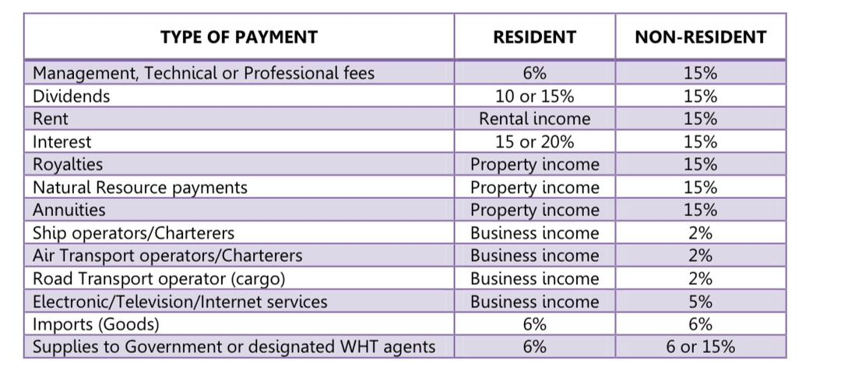
WITHOLDING TAX

Slide 21
Types of taxes in Uganda
VAT (also referred to as Goods and Services Tax in other jurisdictions)
Is a consumption tax charged at a rate of 18% on all supplies made by taxable persons i.e. persons registered or required to register for VAT purposes.
The threshold for VAT registration is an annual turnover of UGX 50m or UGX 12.5m within 3 months of trading.
Some transactions are beyond the scope of VAT and these are classified as Exempt supplies. Supplies on which VAT is charged at 0% are classified as zero-rated supplies.

Slide 22
Customs Duty
This is a tax levied on goods imported (import duty) or exported (export duty) from Uganda at specific or ad valorem rates.
The East African Community Customs Management Act 2004 (EACCMA) is the legal framework for customs operations in Uganda and the region as a whole. A customs union exists between the East African Community States of Uganda, Kenya, Tanzania, Rwanda and Burundi for the main purpose of promoting international trade between the partner states.
The union operates as a single customs territory and trading bloc.

Slide 23
RATIONALE FOR HARMONIZATION OF CUSTOM TARRIFS IN EAC:
Eliminate internal tariffs and non-tariff barriers that could hinder trade between the partner states.
Harmonize policies relating to trade between the partner states and other countries.

Slide 24
Excise Duty
This is a tax that is imposed on specified imported or locally manufactured goods, and services. Essentially it is a tax on “luxury” items.
.The tax is imposed on the value of the import; and in the case of locally manufactured goods, the duty (local excise duty) is payable on the ex-factory price of the manufactured goods.
Exported locally manufactured goods are exempt from excise duty.
Persons supplying excisable goods and services are required to register and file monthly Returns to the tax authority by the 15th day of the month following the month in which delivery of the goods was made.

Slide 25
EXCEPTIONS TO TAX under the EACCMA
Passengers’ Baggage and Personal Effects
Duty Free Allowance for Passengers of majority age
Exemptions for specified categories of people and entities under the 5th Schedule EACCMA i.e the president / diplomats /students / handicapped persons / rally drivers.
Items imported by bona fide persons changing residence /returning residents
Temporary Visit The following goods imported as baggage by a person on a temporary visit not exceeding three months to a partner state may be exempted – ▪ Non-consumable goods imported for personal use and which will be exported at the expiry of the visit..

Slide 26
DISCUSSION
What is the difference between custom and excise duty

Slide 27
Stamp Duty
Stamp Duty is imposed by the Stamps Act.
It is a duty payable on any instrument (document) which upon being created, transferred, limited, extended, extinguished or recorded, confers upon any person, a right or liability.
The most common instruments that attract stamp duty include – Affidavits Agreements or Memorandums of Agreement, Company Articles and Article of Association (0.5%) Caveats, Insurance policies, Powers of Attorney, Promissory Notes, Mortgage Deeds, (0.5%) Debentures (0.5%) Transfer of immovable property (1%)

Slide 28
“The only sure things in life are death and taxes."

